Slide 1
Traffic Simulator 2.0
Team Members:
Matthew Thomson, Rolando Carralero
Product Owner:Kianoosh G. Boroojeni
Instructor: Masoud Sadjadi School of Computing and Information Sciences Florida International University
Final Presentation
Summer 2017
Notes:
7 seconds.( I will select 2 best slides (i will give them extra points and students will present for CIS committee)
Greet your audience, thank them for attending your presentation, introduce yourself, introduce your project, introduce your team members, and quickly indicate what each of you did in a high-level manner, and put more emphasis on your part/contribution.

Slide 2
Project definition
This project is the second version of Traffic Simulator. The first major priority of the new system was to get all of the code into a single web application. The system is unified under a NodeJS and ExpressJS web server. The front end handling the simulation display is served by the web server as an AngularJS application. The back end API and algorithms are handled by ExpressJS and a Python wrapper to run the algorithms in their native language of Python. The new system also displays a side by side comparison with Google Map’s Navigation. The simulation runs off of Google Maps and no longer is coupled with Leaflet and MapQuest.
Notes:
10 seconds.
Introduce the problem that the whole project (in all versions) tackles with GIF or screenshot.

Slide 3
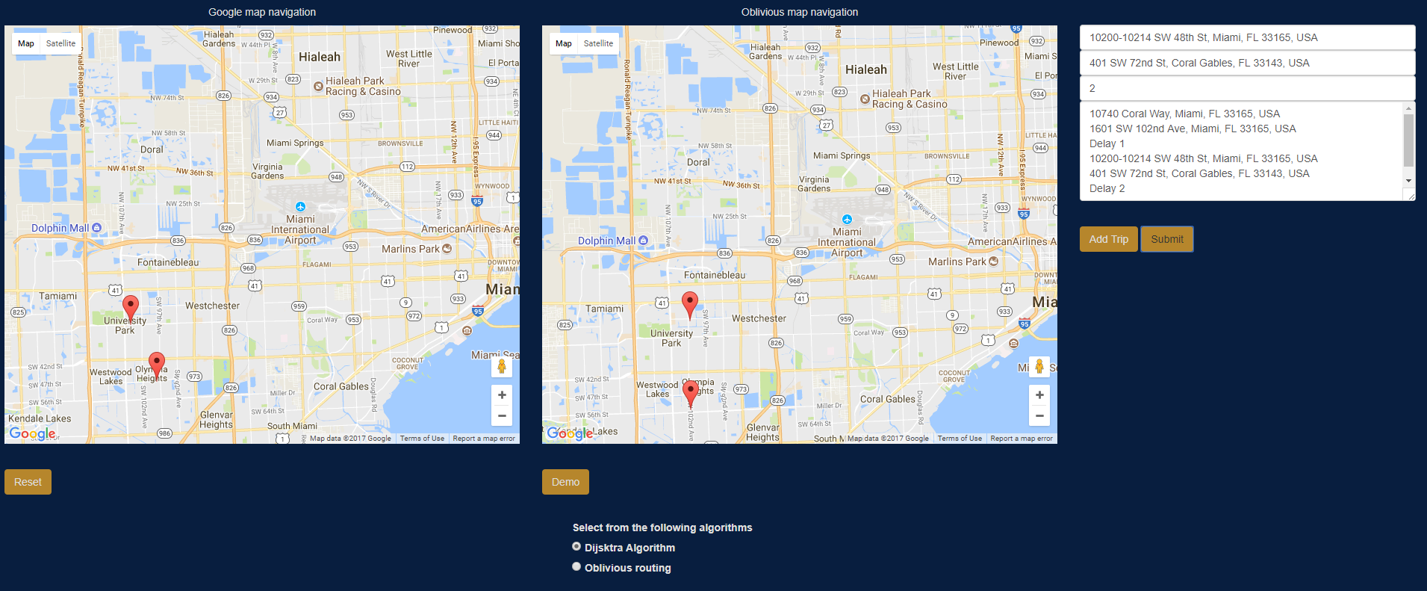
Project definition
Notes:
20 seconds.
Introduce the problem that the your project (in new version) tackles with GIF or screenshot.

Slide 4
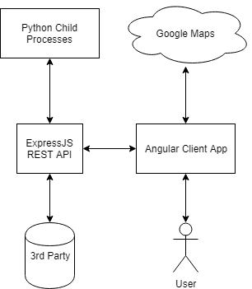
System Design: Architecture
Notes:
20 seconds
System design: Highlight the parts that you contributed to them.
1. System decomposition; identify the architecture patterns used
2. System deployment – h/w and s/w requirements

Slide 5
User Stories
1.User Story #237 - Rewrite API in NodeJS
2.User Story #238 - [API] Initialize Graph
3.User Story #239 - geojson formatting
4.User Story #243 - [API] Python Wrapper
5.User Story #245 - [API] Use Dijkstra Algorithm
6. User Story #264 -[Simulator] Add input fields to enter the data for the maps simulation
7. User Story #278 - [Simulator] Create a submit button to save data entered and display car simulations
8. User Story #279 - [Simulation] Moving Cars
9. User Story #280 - Car Paths
10. User Story #293 - Add button with the functionality of adding trips
Notes:
5 seconds.
List the user stories that you worked on them.(put in order of importance). Stay focused on the parts that you have been working.

Slide 6
User Story #237 -Rewrite API in NodeJs
Description
As a developer, I want to rewrite the 1.0 API in NodeJS, because of experience and familiarity in software and to remove some complications that arose from running Flask.
Acceptance Criteria
The API is supported by a NodeJS web server running ExpressJS that supports the following endpoints.
[POST] /graph – application/json
[POST] /path – application/json
[GET] / – (simulation)
Notes:
60 seconds
The tile of user story
The most important user story you worked on it. You have to describe this one very well and be proud of that.
Please present and show the complexity of your work, code, algorithms, and technical challenges and technologies you have used. (you could use screenshot if you want. Visual presentations are better than text presentation)
Go into the details of the most important/significant tasks using bullet lists or visual graphs or state chart diagram
Sequence Diagram for this user story is mandatory (in another separate page if required)
Demo using screenshots or GIF (in another separate page if required)

Slide 7
Use Case #237 a
Name: Post /graph endpoint
Actor: Client App or 3rd Party
Description:
Actor makes a post request to /api/v2/graph endpoint
Sends adjacency matrix in json format as adjMatrix
Initializes graph #238
Responds with success message
Use Case #237 b
Use Case
Name: Post /path/dijkstra endpoint
Actor: Client App or 3rd Party
Description:
Actor makes a post request to /api/v2/path/dijkstra endpoint
Sends source and destination as lat/lng pairs
Utilizes Dijkstra’s algorithm #245
Responds with array of lat/lng pairs
Use Case #237 c
Use Case
Name: Get / endpoint
Actor: Client App
Description:
Actor makes a get request to / endpoint
Responds with client app

Slide 8
User Story #238 - [API] Initialize
Graph
Description
As a developer, I want to be able to initialize my own graph, because I want to be able to customize the graph in which I use for my application.
Acceptance Criteria
[POST] /graph accepts geojson and generates the graph
Notes:
20 seconds
The tile of user story
Please present and show the complexity of your work, code, algorithms, and technical challenges and technologies you have used. (you could use screenshot if you want. Visual presentations are better than text presentation) - Go into the details of the most important/significant tasks using bullet lists or visual graphs or state chart diagram - Demo using screenshots or GIF (in another separate page if required)
Sequence Diagram for this user story is optional

Slide 9
Use Case #238
Name: Initialize Graph
Actor: Client App or 3rd Party
Precondition:
Adjacency Matrix is properly formatted.
Description:
Actor makes a post request to /api/v2/graph endpoint
Sends adjacency matrix in json format as adjMatrix
Spawns child python process to initialize the graph and return computations provided by version 1.0.
Responds success message

Slide 10
User Story #243 - [API] Python Wrapper
Description
As a developer, I want to be able to write algorithms in Python, because Python provides useful numeric computation libraries such as numpy.
Acceptance Criteria
Python algorithms run from NodeJS.
Notes:
20 seconds
The tile of user story
Please present and show the complexity of your work, code, algorithms, and technical challenges and technologies you have used. (you could use screenshot if you want. Visual presentations are better than text presentation) - Go into the details of the most important/significant tasks using bullet lists or visual graphs or state chart diagram - Demo using screenshots or GIF (in another separate page if required)
Sequence Diagram for this user story is optional

Slide 11
Use Case #243
Name: Python Wrapper
Actor: System
Precondition:
Data required for pending algorithm is formatted properly.
Description:
System invokes a python algorithm through its respective NodeJS wrapper.
NodeJS spawns a child python process and performs I/O to exchange information.
NodeJS wrapper returns appropriate data.

Slide 12
User Story #245- [API] Use Dijkstra Algorithm
Description
As a developer, I want to be able to utilize the Dijkstra Navigation algorithm, because I want to use this algorithm in my pathing decisions for my application.
Acceptance Criteria
Uses the Dijkstra algorithm to determine path
Notes:
20 seconds
The tile of user story
Please present and show the complexity of your work, code, algorithms, and technical challenges and technologies you have used. (you could use screenshot if you want. Visual presentations are better than text presentation) - Go into the details of the most important/significant tasks using bullet lists or visual graphs or state chart diagram - Demo using screenshots or GIF (in another separate page if required)
Sequence Diagram for this user story is optional

Slide 13
Use Case #245
Name: Dijkstra
Actor: Client App or 3rd Party
Precondition:
Graph is initialized already.
Description:
Actor makes a post request to /api/v2/path/dijkstra endpoint
Sends source and destination as lat/lng pairs
Python algorithm from version 1.0 calculates the results.
Responds with array of lat/lng pairs representing the path between source and destination.

Slide 14
User Story #264 - [Simulator] Add input fields to enter the data for the maps simulation
Description
As a user, I want to be able to enter my origin address and my destination address to create my trip so I can visualize possible routes
Acceptance Criteria
Have 3 input fields to enter the trip data, origin, destination and time.
User must be able to enter as many trips as desired
Print trips entered on a textarea.
User Story #293 - Add a button with functionality of adding trips
Description
As a user I would like to add as many trips as I want to my list of trips before showing the routes and car animations in the maps(use submit button for this functionality). This way there are not animations running in the maps if I have not finished to enter the trips.
Acceptance Criteria
Showing a trip with the three fields (source, destination and time) in the textarea every time the user click the button add trip and there is user input for the three fields.
Repeat last trip entered data if there is not user input for the three fields and add trip button is clicked.
Not showing animations on the maps when the add trip button is clicked. Separate functionality from submit button.
Notes:
20 seconds
The tile of user story
Please present and show the complexity of your work, code, algorithms, and technical challenges and technologies you have used. (you could use screenshot if you want. Visual presentations are better than text presentation) - Go into the details of the most important/significant tasks using bullet lists or visual graphs or state chart diagram - Demo using screenshots or GIF (in another separate page if required)
Sequence Diagram for this user story is optional

Slide 15
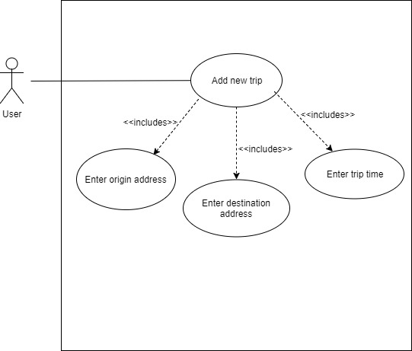
Use Case #264
Name: Enter data to input fields
Actor: User
Preconditions:
Web page running at localhost:8080
User is at the homepage
Description:
User enters input to source address field
User enters input to destination address field
User enters input to time field
User selects addTrip button to print the trip created
Use Case #293
Name: Print trips
Actor: User
Preconditions:
User is at the homepage
Description:
User enters at least one trip with the three fields required: source, destination and time.
User selects Add Trip button
System responds by displaying the data entered for the trip on the textarea

Slide 16
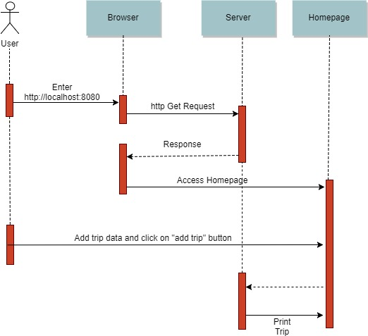
Sequence diagram, user stories #264 and #293.

Slide 17
User Story #278- Create a submit button to send data entered and display car paths and simulations
Description
As a user I want to save every input trip entered and submit it when all the information required is completed with a button, so it can be displayed on the maps.
Acceptance Criteria
Displaying all the information recollected in the input fields such as source and destination address for every trip in the maps and showing the car animations when clicking the submit button

Slide 18
Use Case #278
Name: Submit data entered by user
Actor: User
Preconditions:
User is at the homepage
User has entered at least one trip with the three fields required: source, destination and time.
Algorithm selected for Oblivious map navigation.
Description:
User selects Submit button
System responds by displaying route/s for each trip entered in the maps.

Slide 19
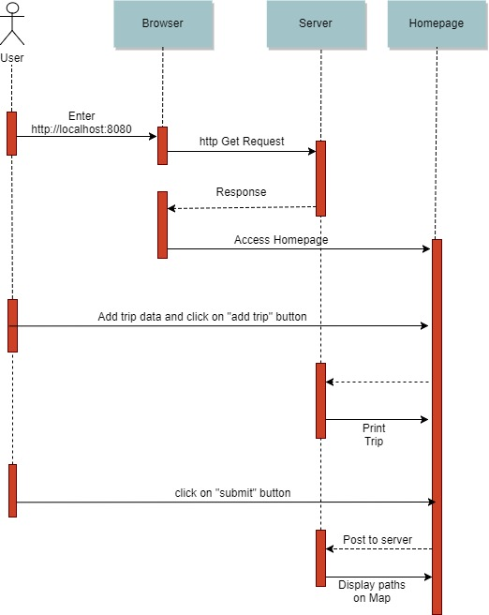
Sequence diagram, User Story#278

Slide 20
User Story #279-[Simulation] Moving Cars
Description
As a user, I want to be able to see the cars moving along the path chosen by the algorithm.
Acceptance Criteria
Cars move smoothly from source to destination following the given path.
Cars move in a base unit of time (1 second) from point A to point B regardless of distance.
Cars disappear one second after reaching destination.

Slide 21
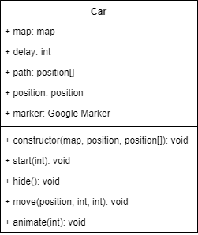
Use Case #279
Class Diagram
Name: Car Animation
Actor: User
Preconditions:
User has submitted at least one trip.
Description:
A Google Maps marker will appear at the specified location based on the chosen algorithm.
The marker will animate to the next point in the path after 1 second.
The marker will disappear after 1 second after reaching its destination.

Slide 22
User Story #280- Car Paths
Description
As a user, I want to see the correct path chosen by my choice of algorithms, because I want to see the difference between algorithms.
Acceptance Criteria
Utilizes the server API for getting paths.
Animates the car along the path

Slide 23
Use Case #280 a
Name: Showing car paths using Dijkstra algorithm
Actor: User
Preconditions:
User already entered at least one trip with the three fields required: source, destination and time.
Description:
User selects Dijkstra radio button
User selects Submit button
System responds by displaying car paths determined by Dijkstra algorithm and car animations along the paths on the Oblivious map navigation
Use Case #280 b
Name: Showing car paths using Oblivious algorithm
Actor: User
Preconditions:
User already entered at least one trip with the three fields required: source, destination and time.
Description:
User selects Oblivious radio button
User selects Submit button
System responds by displaying car paths determined by Oblivious algorithm and car animations along the paths on the Oblivious map navigation

Slide 24
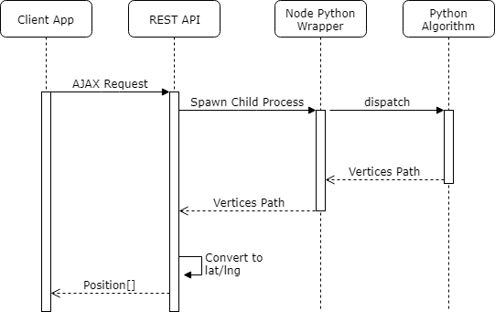
Sequence diagram, user story #280

Slide 25
Test Suites and Test Cases
Test case ID: Add_Trip_005
Description/Summary of Test: A user enters valid values the three input fields and clicks the add trip button Pre-condition: User is at Traffic Simulator home page Expected Results: Trip created and printed on the textarea with the three valid values entered by the user Actual Result: Trip created and printed on the textarea with the three valid values entered by the user Status : Passed
Notes:
10 seconds
A description of verification process and Test Suites and Test Cases for one of the use cases.
1 One sunny day and one rainy day for the implemented use cases (one or more slides).
2 Automated test scripts for the implemented use cases (if any) (one or more slides).

Slide 26
Test Suites and Test Cases
Test case ID: Select_Algorithm_001
Description/Summary of Test: User creates a trip or some trips filling out the required fields. User selects Dijkstra algorithm to determine car paths. Then user selects Submit button Pre-condition: -User is at Traffic Simulator home page
-User created at least one trip Expected Results: Car paths are determined by Dijkstra algorithm and displayed on the oblivious map navigation Actual Result: Car paths are determined by Dijkstra algorithm and displayed on the oblivious map navigation Status : Passed

Slide 27
Summary
This project is the second version of the system.
The web application runs with angularjs in the frontend and Nodejs and ExpressJs web servers.
It contains two maps(using google mapping) to show paths from different routing algorithms
Use inputs from users to create trips and routing algorithms to determinate the paths to be displayed on the maps.
Notes:
10 seconds
Summarize your contribution, mention your effort for Scrum, Mingle, Github, Google Drive Documentation and minutes
Include your contact information
Ask if anyone has any questions for you.
Thank your audience

Slide 28








Thank you, any questions?
Matthew Thomson: mthom031@fiu.edu
Rolando Carralero: rcarr085@fiu.edu

